Slide 1
ONNX & Cognitive Service Read API
Yung-Shin Lin
Microsoft Azure/Cognitive Service/Text Intelligence
OCR Core Engine Team
Principal Engineering Manager

Slide 2
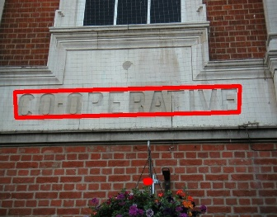








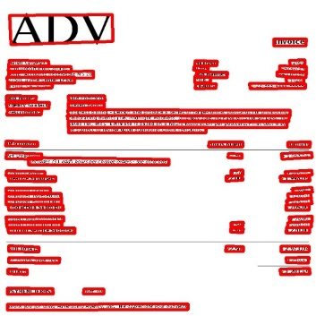
Microsoft Cognitive Service Read API
Street View
Product Label
Poster
Business Card
Microsoft Cognitive Service
Cloud-based AI offering.
Our team: Read API
A state-of-art Optical Character Recognition (OCR) engine using deep learning models.
Read API Features:
Support both printed text and handwritten text.
Great for real-world images.
Search for “Cognitive Service Computer Vision” for more info.
Slide
GIF
Book Cover
Document
Receipt
Invoice

Slide 3
Challenges before Using ONNX
In late 2018, need a modern training and inference framework.
Previously, we used a home-grown inference engine.
Researchers was switching to PyTorch to do research work.
Mismatch between research and production.
Performance challenges
Our home-grown inference engine needs to achieve at least 3X speed boost to reduce operation cost in running service.
Caffe2 did not meet our performance expectation too.

Slide 4
Why Switching to ONNX?
A modern framework for research, training and inference.
PyTorch for researching and training
ONNX runtime for inference
Straight from research to production
Researcher’s PyTorch model can export ONNX model directly
Easy to port researchers’ Python inference code to our production C++ code.
Runtime Performance Boost
ONNX runtime is highly optimized for interference.
Runtime is well suited for service deployment.
Great support from ONNX runtime team.

Slide 5
Read 2.0 Porting Experience
Read 2.0 is a Windows-based cloud service
Use Caffe2 to export our models to ONNX
Use Custom Ops support in ONNX to extend op support
Use ONNX C++ API in Windows
Very Easy to use
Take about 2 weeks to port and test.
Focus on verification and performance tuning
Service deployment testing

Slide 6
Performance Gain via ONNX Runtime
3.7x latency improvement compared to our home-brew inference framework.
Helped us to over-achieve our 3X perf goal.

Slide 7
Read 3.0 Preview: Road to Linux
For Read 3.0 preview, we wanted to move Kubernetes-based service
Better scalability and reliability.
Business demands on Linux containers.
We need to port from Windows to Linux.
The cross-platform nature of ONNX runtime helps us to migrate to Linux very easily.
Even faster inference in Linux.

Slide 8
Takeaway for our ONNX Journey
ONNX
Great from research to production.
ONNX Runtime
Great for easy-of-development, deployment and performance.
Great fit for Kubernetes deployment and container offer.
Our new feature development now centralized in ONNX and ONNX runtime.

